Slide 1
Unit 4
Constructing Enterprise Applications

Slide 2
Constructing Enterprise Applications
Construction of an enterprise application involves converting design into code to built an application
Construction phase involves the following activities
1. Achieving construction readiness
2. Constructing solution layer (application framework and application components)
3. Code review and static code analysis
4. Compilation and creating deployable packages
5. Unit testing
6. Code profiling and code coverage analysis

Slide 3
1. Construction Readiness
Some activities are carried out before we are starting our construction work
They are,
a. Defining a Construction Plan
A construction plan will consist of the sequence and schedule of tasks required to be carried out in the construction phase, their interdependencies, technical risks, and resources required to implement the task.
The primary objective of the plan is to complete the construction phase in the shortest time possible, while not compromising on functionality and quality requirements.
b. Defining a Package Structure
The code that are created during construction phase have to be structured in a meaningful way
The package structure reflects the physical organization of the units of code.
It provides a clear picture to the developer about the location of classes they develop relative to rest of the code.

Slide 4
1. Construction Readiness (contd..)
c. Setting up a Configuration Management Plan
The evolution of artifacts through several versions has to be tracked in order to ensure the integrity and consistency of the artifacts, and is referred to as configuration management.
The artifacts that are managed are referred to as configuration objects.
Configuration management plan provides basis for managing the configuration objects by specifying the tool to be used
d. Setting up a Development Environment
A development environment is the construction ecosystem where developers develop, build, review, verify and analyze code components of an application under development.
The following elements are set up as part of the development environment

Slide 5
1. Construction Readiness (contd..)
Hardware including operating systems
Servers such as application, Web, database, directory and portal servers
Integrated development environment
Third-party libraries
Build tools
Unit testing tool
Profiling tool
Static code analysis tool
Licenses for all the required software
The following key activities are followed to set up a development environment
1. Installation and Configuration of servers
- servers like File servers, Database servers and application servers
2. Setting up the Integration Development Environment (IDE)
- IDE is configured with relevant libraries, plug-ins, database and server configurations
3. Setting up Frameworks
- Enterprise applications are built using libraries in the framework
- Setting up frameworks involves importing libraries in the framework in the IDEs

Slide 6
Software Construction Map
To understand the design and translate it into code, a developer need a more information on the design
For better understanding of components, design elements are represented in different forms to visualize the overall solution from developer perspective. This new form of representation is called as Software Construction Map (SCM)

Slide 7
2. Constructing solution layers
Construction of enterprise applications do not start from the scratch, rather the organizations use reusable assets.
Application framework is one of the most important reusable components
A repository of technical components and repository of domain specific components are used for constructing solution layers
Components in the technical solution layers include
Infrastructure services layer components
Presentation layer components
Business layer components
Data access layer components
Integration layer components

Slide 8
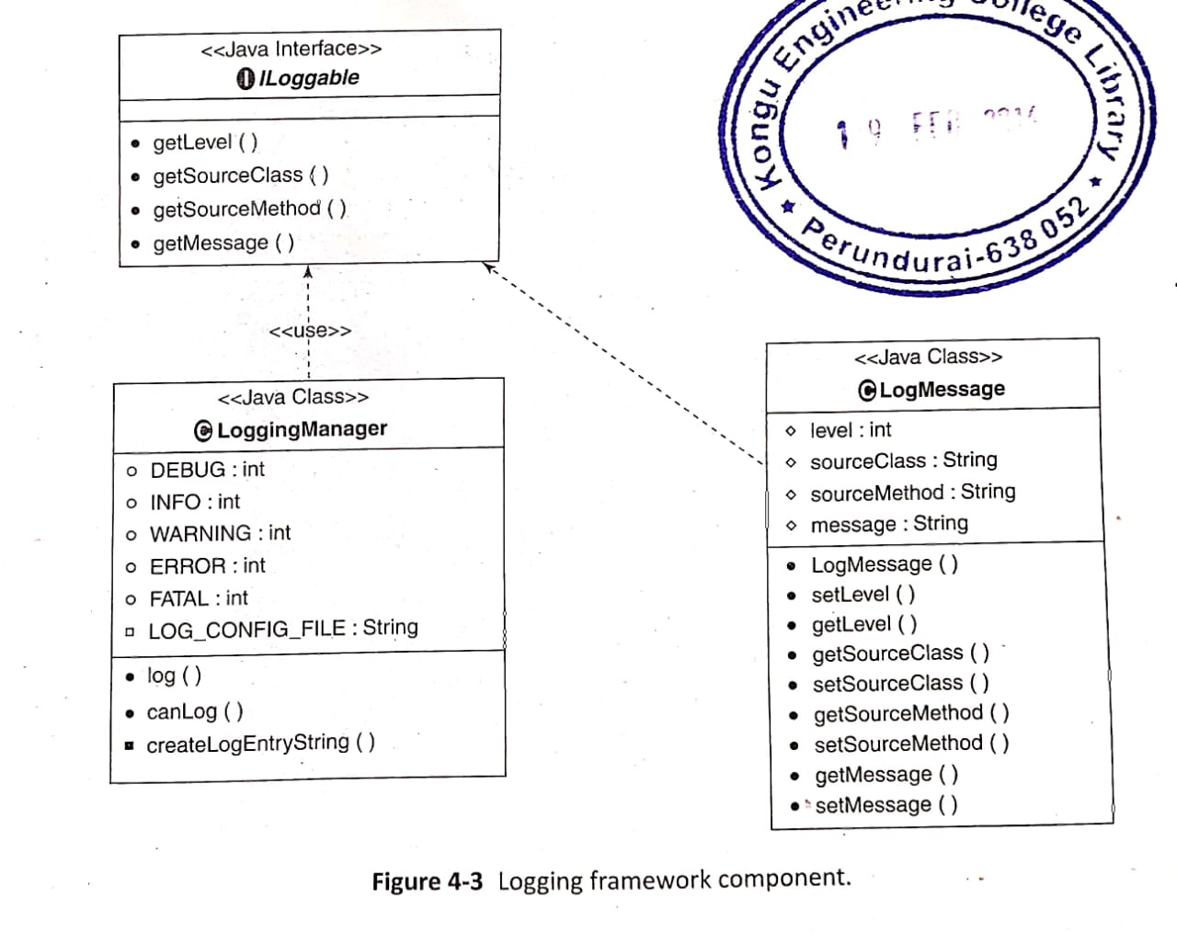
2. Constructing solution layers (contd..)
a) Infrastructure services layer components
Infrastructure service layer contains components like logging, session management, security, exception handling, auditing, caching, notification and reporting
Construction of these components are explained below:
Logging
Package Log4J is used to implement logging functionality
Logging Manager class in java encapsulates this Log4J package
Logging Manager class contains log() method to write statements to log file
LogMessage class takes care of setting the log level, source class, source method and logging message

Slide 9
2. Constructing solution layers (contd..)
a) Infrastructure services layer components
2. Exception Handling
Handling of errors occurring at the runtime is called Exception handling
Some of the java classes used for Exception handling are:
1. Exception
2. BaseException
3. SystemException
4. BusinessException
5. BusinessValidationException
6. RuntimeException
7. ExceptionHelper
8. BaseRuntimeException

Slide 10
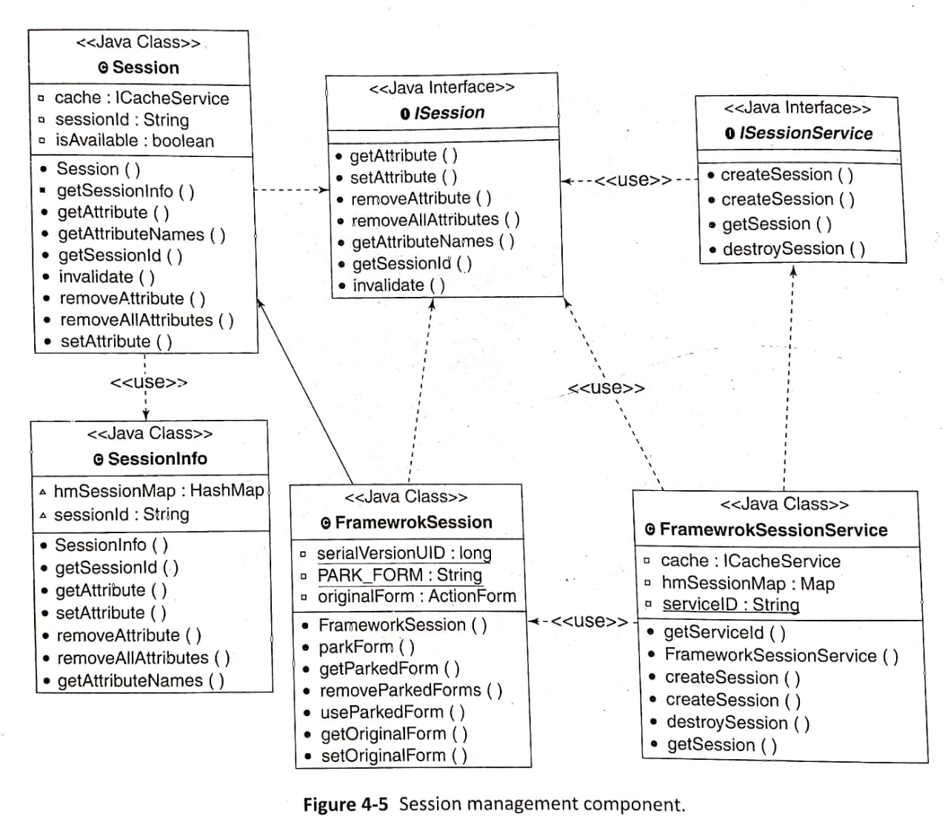
2. Constructing solution layers (contd..)
a) Infrastructure services layer components
3. Session Management
After successful authentication of users, a unique session ID is created.
The session ID gets stored in HttpSession
Below diagram shows Java classes used for session management. Session class contains the logic for creation of session

Slide 11
2. Constructing solution layers (contd..)
a) Infrastructure services layer components
3. Session Management
Session Management Features
1. Session affinity: It is mechanism where all requests of a session are directed to a particular
node of the clustered environment
2. Session tracking: Session tracking is a mechanism to use cookies for session management. Session Id are generated by servers and returned in cookies to browser.
3. In-memory session and persistent session: session attributes are stored in memory or persisted in a database

Slide 12
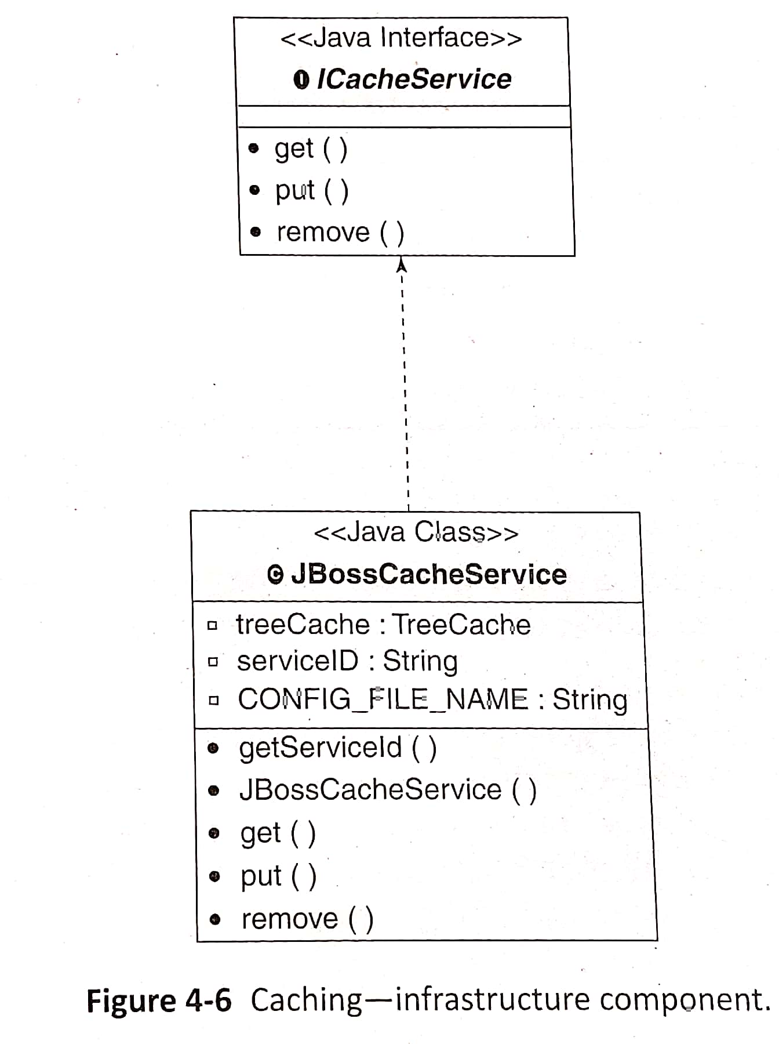
2. Constructing solution layers (contd..)
a) Infrastructure services layer components
4. Caching
Caching is used to improve the performance of the application where frequent accessed data are moved from secondary store to the cache memory
ICacheService is an interface that have get(), put() and remove() methods.
These methods are used for reading, writing and removing content from the cache

Slide 13
2. Constructing solution layers (contd..)
b) Presentation layer components
Simplest options to construct the presentation layer components in the enterprise application is by using JSP, servlet and plain old Java object (POJO) components
Presentation layer can be constructed using several frameworks such as Struts, JSF(Java Server Faces), Tapestry and Stripes among which Structs and JSF are the popular frameworks
JSF vs Structs
JSF | Structs
JSF is a Java EE standard | Structs is not part of the Java EE specifications
Follows and event-driven model where components of JSF page trigger appropriate events | Follows and action-driven model where page request is treated as a single event
Based on standard UI component model | Does not have a standard UI component model

Slide 14
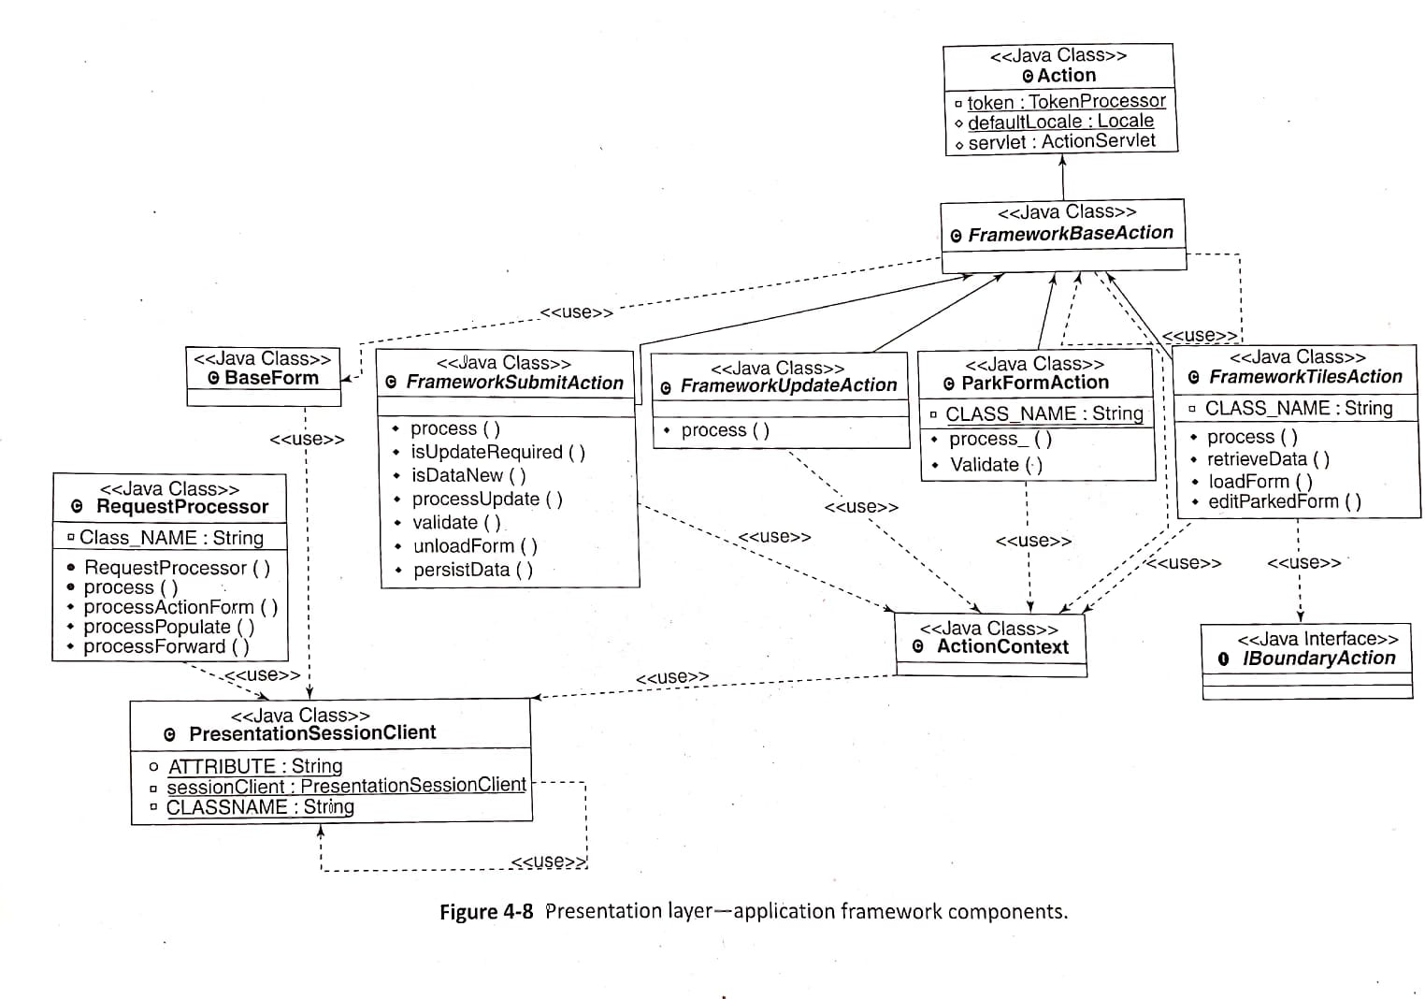
2. Constructing solution layers (contd..)
b) Presentation layer components
Presentation layer application framework components extends the Structs framework
It uses FrameworkBaseAction class which is inherited from Structs Action class

Slide 15
2. Constructing solution layers (contd..)
b) Presentation layer components
FrameworkTilesAction classes are used for displaying the page. retrieveData() method in this class is used to retrieve all the data to display in the page
FrameworkSubmitAction class is used to process the POST request. It is used to submit data from the browser to the server
FrameworkUpdateAction class is used for handling the actions that update the view
ParkFormAction class is used to park the form. Parking the form means saving the form data temporarily in the web session instead of storing in the database
ActionContext class is used for organizing the parameters

Slide 16
2. Constructing solution layers (contd..)
c) Business layer components
The construction of business layer components can also be done in several ways. Implementation using POJO is among the simplest of the options available
Spring framework and EJB 3.0 (Enterprise Java Bean) can also be used to implement business layer components
Two important features of Spring framework are:
1. Inversion of Control (IoC)
- IoC container creates the objects, configures and assembles their
dependencies, manages their entire life cycle. The dependencies
among java objects is stored in a configuration file
2. Dependency injection (DI)
- The dependency information among objects is used by IoC and
“injects” the referenced object on demand which is called as
Dependency injection

Slide 17
2. Constructing solution layers (contd..)
c) Business layer components
EJB 3.0 vs Spring Framework
EJB 3.0 | Spring Framework
EJB 3.0 is a Java EE standard | Spring Framework is an open source framework and is not a java standard
EJB 3.0 maintains state using stateful session EJB | Spring framework maintains state using non-singleton and scoped beans
EJB 3.0 has least support for dependency injection | Spring framework has more support for dependency injection

Slide 18
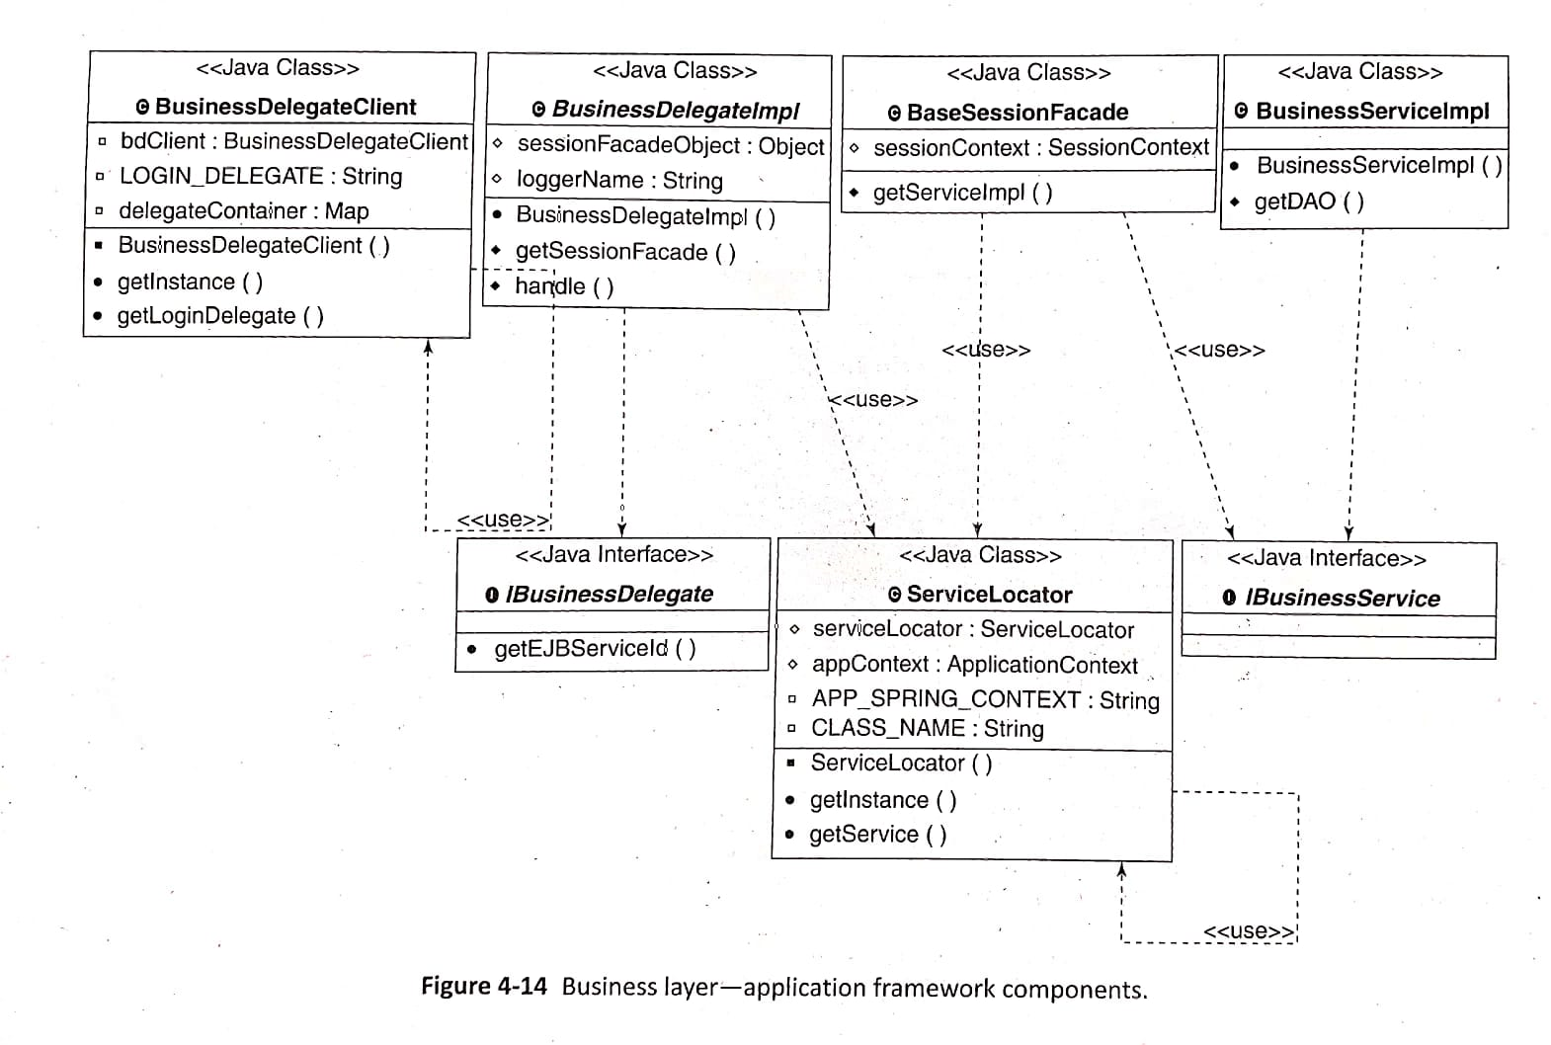
2. Constructing solution layers (contd..)
c) Business layer components
Business layer contains components like Business Delegate components, session façade components, business service components and business model components
Below diagram shows different Java classes used for constructing Business layer

Slide 19
2. Constructing solution layers (contd..)
c) Business layer components
There are 3 elements for Business Delegate components (refer diagram in previous slide)
1. IBusinessDelegate is the business delegate interface
2. BusinessDelegateImpl is an implementation of IBusinessDelegate
interface
3. BusinessDelegateClient class is used by presentation layer to get
Business delegate objects
There are 2 elements for Business Service components (refer diagram in previous slide)
1. IBusinessService is the business service interface
2. BusinessServiceImpl is an implementation of IBusinessService interface

Slide 20
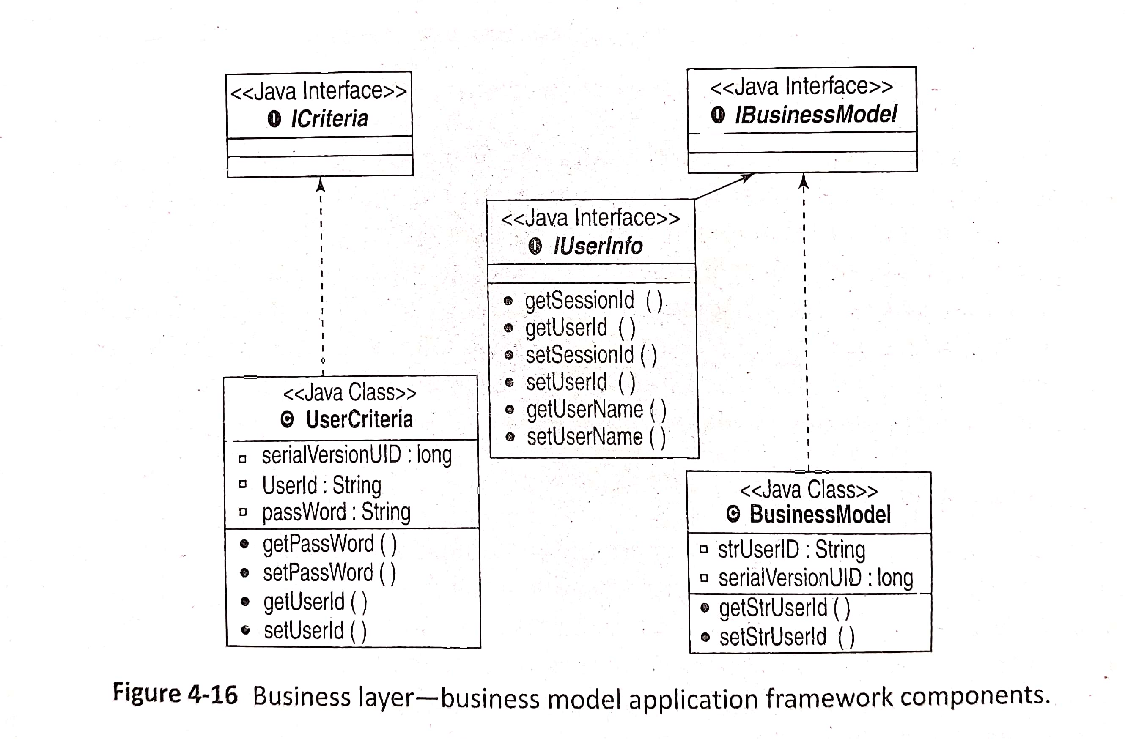
2. Constructing solution layers (contd..)
c) Business layer components
There are 3 elements for Business Model components
1. IBusinessModel is the business model interface
2. BusinessModel is an implementation of IBusinessModel interface
3. Icriteria interface. Objects that implements this interface contains request parameter to perform business operations

Slide 21
2. Constructing solution layers (contd..)
d) Data Access layer components
The simplest of the data access layer technologies is Java Database Connectivity (JDBC), wherein SQL queries are directly embedded in Java code. This may lead to a tight coupling between Java objects and the underlying relational data stores.
Object Relation Mapping (ORM) has come into practice to avoid coupling between java objects and relational data stores
Hibernate, Java Persistance API (JPA), EJB, TopLink, iBatis are the popular technologies that provide ORM based implementation of Data Access layer

Slide 22
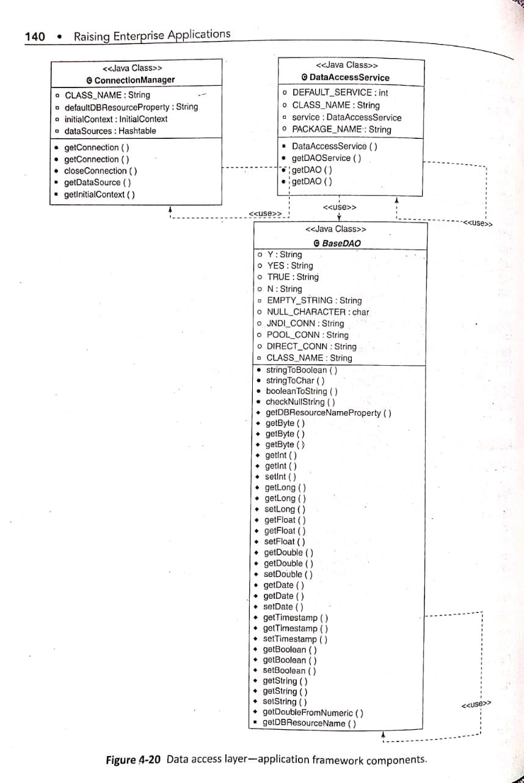
2. Constructing solution layers (contd..)
d) Data Access layer components
Below diagram shows the classes used in Data Access layer
DAO encapsulates the mechanism to access the underlying data stores

Slide 23
2. Constructing solution layers (contd..)
e) Integration layer components
Construction of integration layer components can be done in a variety of ways, and at different levels
Integration layer of LoMS uses JAX-WS API to implement the SOAP-based Web services integration between LoMS and credit rating system.

Slide 24
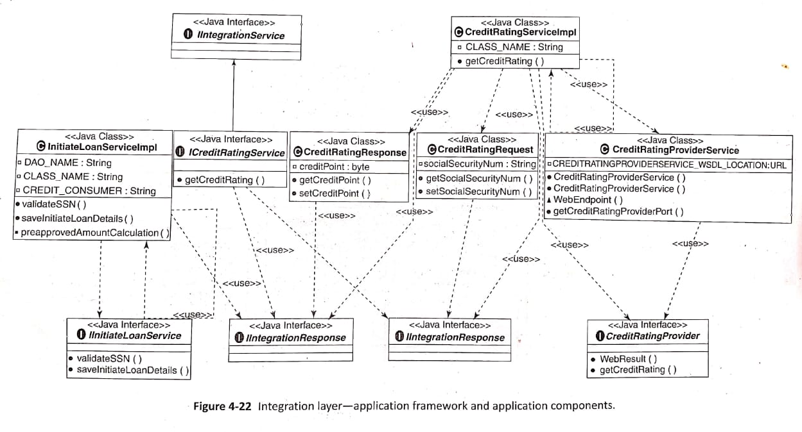
2. Constructing solution layers (contd..)
e) Integration layer components
Below diagram shows the Java classes used Integration layer
IIntegrationService contains Web service consumers implementation
IIntegrationRequest and IIntegrationResponse contains parameters for communication between Web service consumer and Web service provider

Slide 25
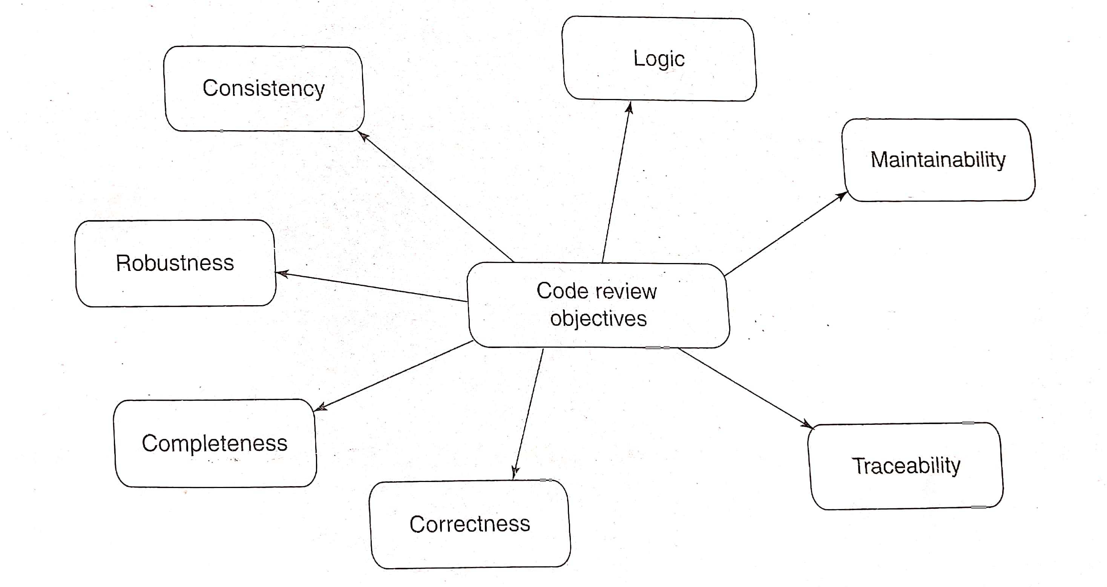
3. Code Review
Code artifacts are reviewed in this construction phase
Objectives of Code Review
The objectives of code review are shown in below diagram

Slide 26
3. Code Review (contd..)
Objectives of Code Review
Completeness – ensures whether code is in line with the design and requirements
Correctness – ensures whether code is written using the coding best practices
Consistency – ensures uniformity in coding, error and exception handling
Maintainability – ensures whether code is easily understood and maintainable
Traceability - takes care whether source code of software can be traced back to its functional requirements and design
Robustness – Ensures code should be able to handle errors and unexcepted events at runtime

Slide 27
3. Code Review (contd..)
Code Review process
Right set of reviewers are identified for code review
Following are the some of the things Reviewers will check in the code:
a. Input/Output errors
b. Unused variables
c. Computational errors, Comparison errors, Control flow errors
d. Infinite or improperly terminated loops
e. Wrong declaration
f. Unhandled exceptions and error conditions
g. Error messages
h. Contention and Deadlocks
i. Data declaration errors
Code reviews may be performed manually or in an automated fashion against certain set of guidelines and best practices.
Reviews can be conducted in multiple forms. Review can be structured or unstructured, formal or informal, a self review or a peer review, or a code walkthrough driven by the developer or by the reviewer.

Slide 28
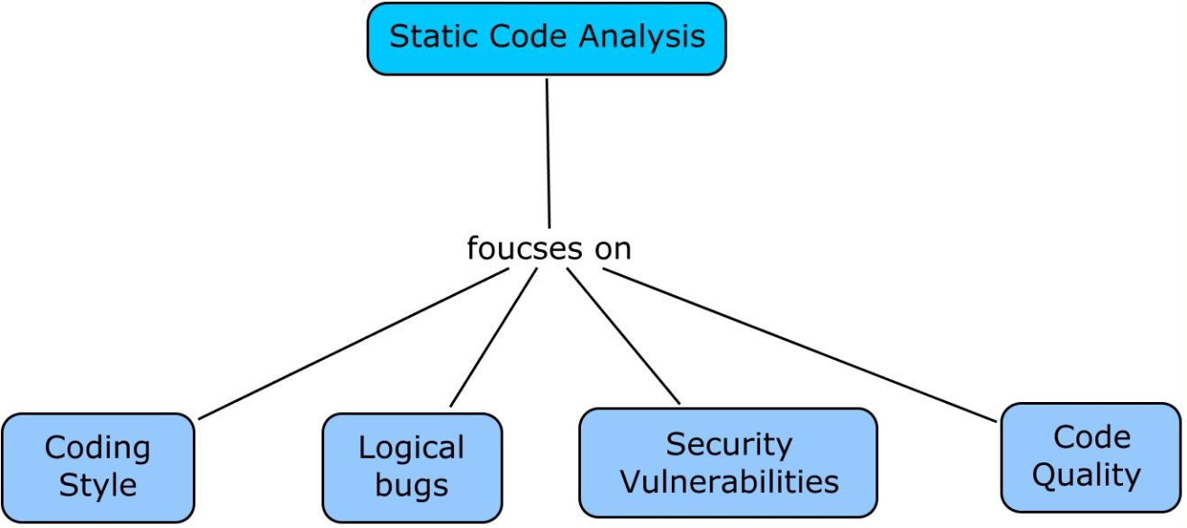
4. Static Code Analysis
Static code analysis is an activity of analyzing the code to identify various issues related to non-runtime aspects of the code
Static code analysis involves analyzing the code without even compiling the code
Static code analysis focuses on analysis of coding style, bug finding, finding security related vulnerabilities and code quality analysis
Static code analysis is an automated activity that can be performed using tools [Eg: Findbugs, ChechkStyle]

Slide 29
4. Static Code Analysis (contd..)
(i) Coding Style
Coding style check focuses on use of right language features such as use of apt control constructs, appropriate language idioms and right type of data structures.
Checks whether code is correctly formatted
(ii) Logical Bugs
While finding logical bugs is essentially the duty of manual code review activity, a small subset of bugs may also be identified through encoded rules verified as part of static code analysis.

Slide 30
4. Static Code Analysis (contd..)
(iii)Security Vulnerabilities
Security is an essential component of enterprise applications, and starts from its inception.
Developers and reviewers also have to follow various secure coding practices to ensure the development of secure code.
Few of the vulnerabilities are:
1. Cross-site scripting
- Attackers pass malicious scripts through form fields in the UI of application
- When user requests HTML page containing the form, the malicious scripts are passed to user’s browser and executed on client machine
2. SQL Injection
- most terrible application vulnerabilities
- attacker change the logic of underlying SQL query by injecting malicious SQL from the form fields
- This causes unauthorized access or modification of data

Slide 31
4. Static Code Analysis (contd..)
3. Improper session handling
- Developers and reviewers have to take care whether session time out has been set, whether session of a user request have been validated
- Authentication and authorization should be checked
- Sensitive data like user credentials are not present
(iv) Code Quality
Code quality analysis is important to ensure that code being delivered is of the highest quality in terms of its modularity, extensibility, maintainability, reusability, testability and performance.
Some of the metrics used to measure the code quality are:
1. Class size: size of class in terms of lines of code. Big classes having more than 1000 lines of code have poor readability
2. Cyclomatic complexity: measures number of possible paths through the method. Loops should be minimized, unnecessary conditions should be
eliminated, nested loops should be avoided to lower this metric

Slide 32
4. Static Code Analysis (contd..)
3. Comments-to-code ratio: Measures ratio between comments to total line of line. Lower
comment ratio results in difficulty in understanding the code
4. Number of attributes: Measures number of attributes (variables) in class.
5. Coupling between objects: This metric represents number of other classes to which a class is coupled

Slide 33
5.Build Process and Unit Testing
Build Process
Every enterprise application requires an accurate, automated and maintainable build process in order to effectively and efficiently build an application.
The build process is not limited only to the compilation of source code, but also comprises of other key activities such as retrieving the appropriate set of code units from source code control systems, packaging application components and libraries, component specific compilation, and deploying the application into a development environment.
Tools such as Apache Ant and Maven are used to automate the build process of Java based enterprise applications.

Slide 34
5.Build Process and Unit Testing (contd..)
Unit Testing
Unit testing is the first formal level of testing, where individual units of software are tested, independent of other part(s) of an enterprise application.
Units can be modules, procedures, methods or classes of software development.
Developers have to deliver unit tested code
Unit testing can be a manual process or is automated by using testing frameworks/tools like JUnit.

Slide 35
5.Build Process and Unit Testing (contd..)
3 steps in Unit Testing
1. Test planning
- first step which involves documenting steps to be followed to carry out testing
2. Test cases and test data preparation
- The diagram shows the elements to be present in test cases
3. Execution of test cases and fixing the bugs
- Test cases are executed and actual results are compared with excepted results
- Bug fixing is done for all the failed test cases

Slide 36
6. Dynamic Code Analysis
Dynamic code analysis provides the view of application in the running state
Whereas static code analysis involves analyzing the code without even compiling the code
Dynamic code analysis focuses on,
1. Code Profiling
2. Code coverage

Slide 37
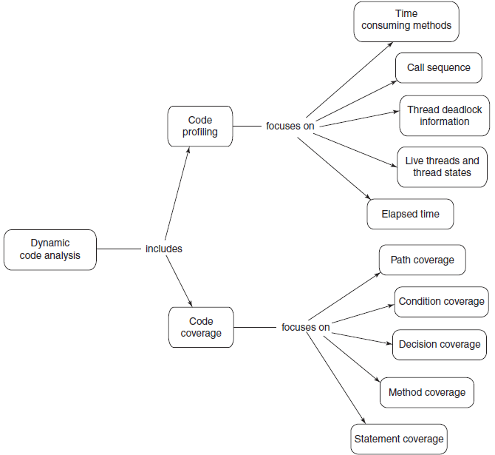
6. Dynamic Code Analysis
Below diagram shows the objectives of dynamic code analysis

Slide 38
6. Dynamic Code Analysis (contd..)
1. Code Profiling
Code Profiling focuses on performance analysis of an application
Code Profiling captures various run-time attributes of the code. Few of the run-time attributes are,
1. Time consumed by methods: Time taken by CPU to complete the execution of methods
2. Call Sequence: Lists the actual sequence of method calls in the particular execution of
the program
3. Thread Deadlock information: Identifies sequences which are sources of deadlock
4. List of Live threads and thread states: provides information on live threads and its state
5. Elapsed Time: Includes sleep time, program pauses and I/O waits

Slide 39
6. Dynamic Code Analysis (contd..)
2. Code Coverage
Code coverage is defined as the level or percentage to which the source code of an application is tested
Code coverage includes following metrics,
1. Statement coverage: measures the degree to which statements of the application have been
covered during test execution
2. Method coverage: measures the degree to which methods or functions of the application
have been covered during test execution
3. Decision coverage: measures the degree to which boolean conditions of all decision and
looping constructs of the application have been covered during testing
4. Condition coverage: measures the degree to which boolean conditions of all Boolean
expressions have been covered during testing
5. Path coverage: measures the degree to which all possible logical flows have been covered
during testing

